Slide 1
SOLELY FOR PURPOSES OF FORAGE WORK EXPERIENCE
Customer Review Analysis
British Airways

Slide 2
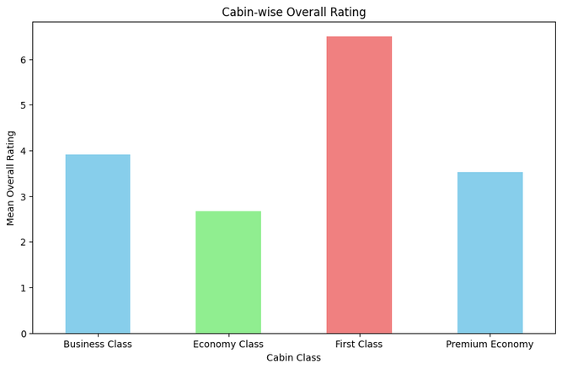
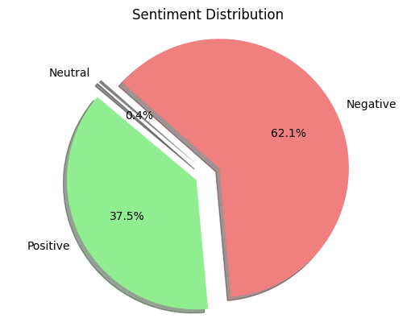
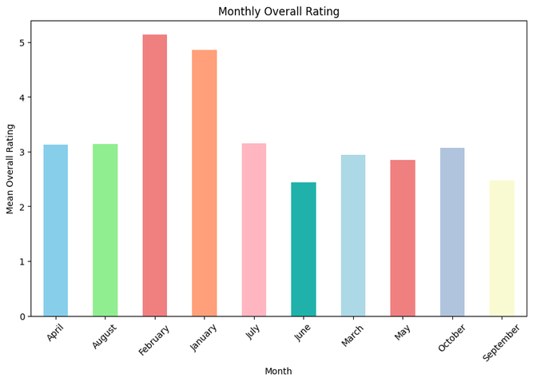
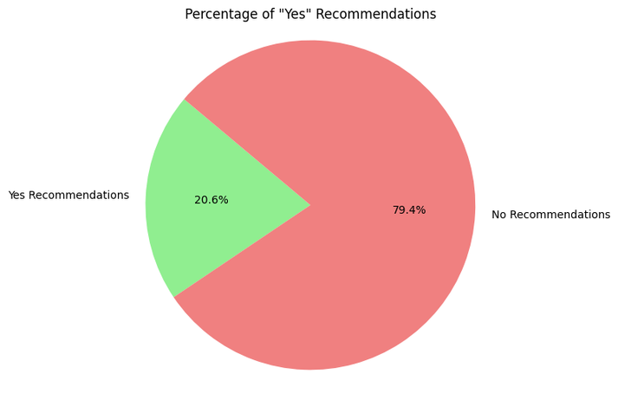

SOLELY FOR PURPOSES OF FORAGE WORK EXPERIENCE
1. Overall Average Ratings:
The average overall rating for British Airways during Jan - Oct 2023 was approximately 3.15 out of 10.
Distribution of the reviews
2. Monthly Average Overall Ratings:
The highest average overall ratings were observed in February and January
4. Recommendations:
Approximately 10% of the reviews indicated a "Yes" recommendation, suggesting a relatively low rate of positive recommendations.
Word cloud of the negative reviews
3. Average Ratings by Cabin Class:
First Class received the highest average overall rating at 6.5 out of 10.
Economy Class had the lowest average rating at 2.67.

